Slide 1
AIRLINE PASSENGER SATISFACTION

Slide 2
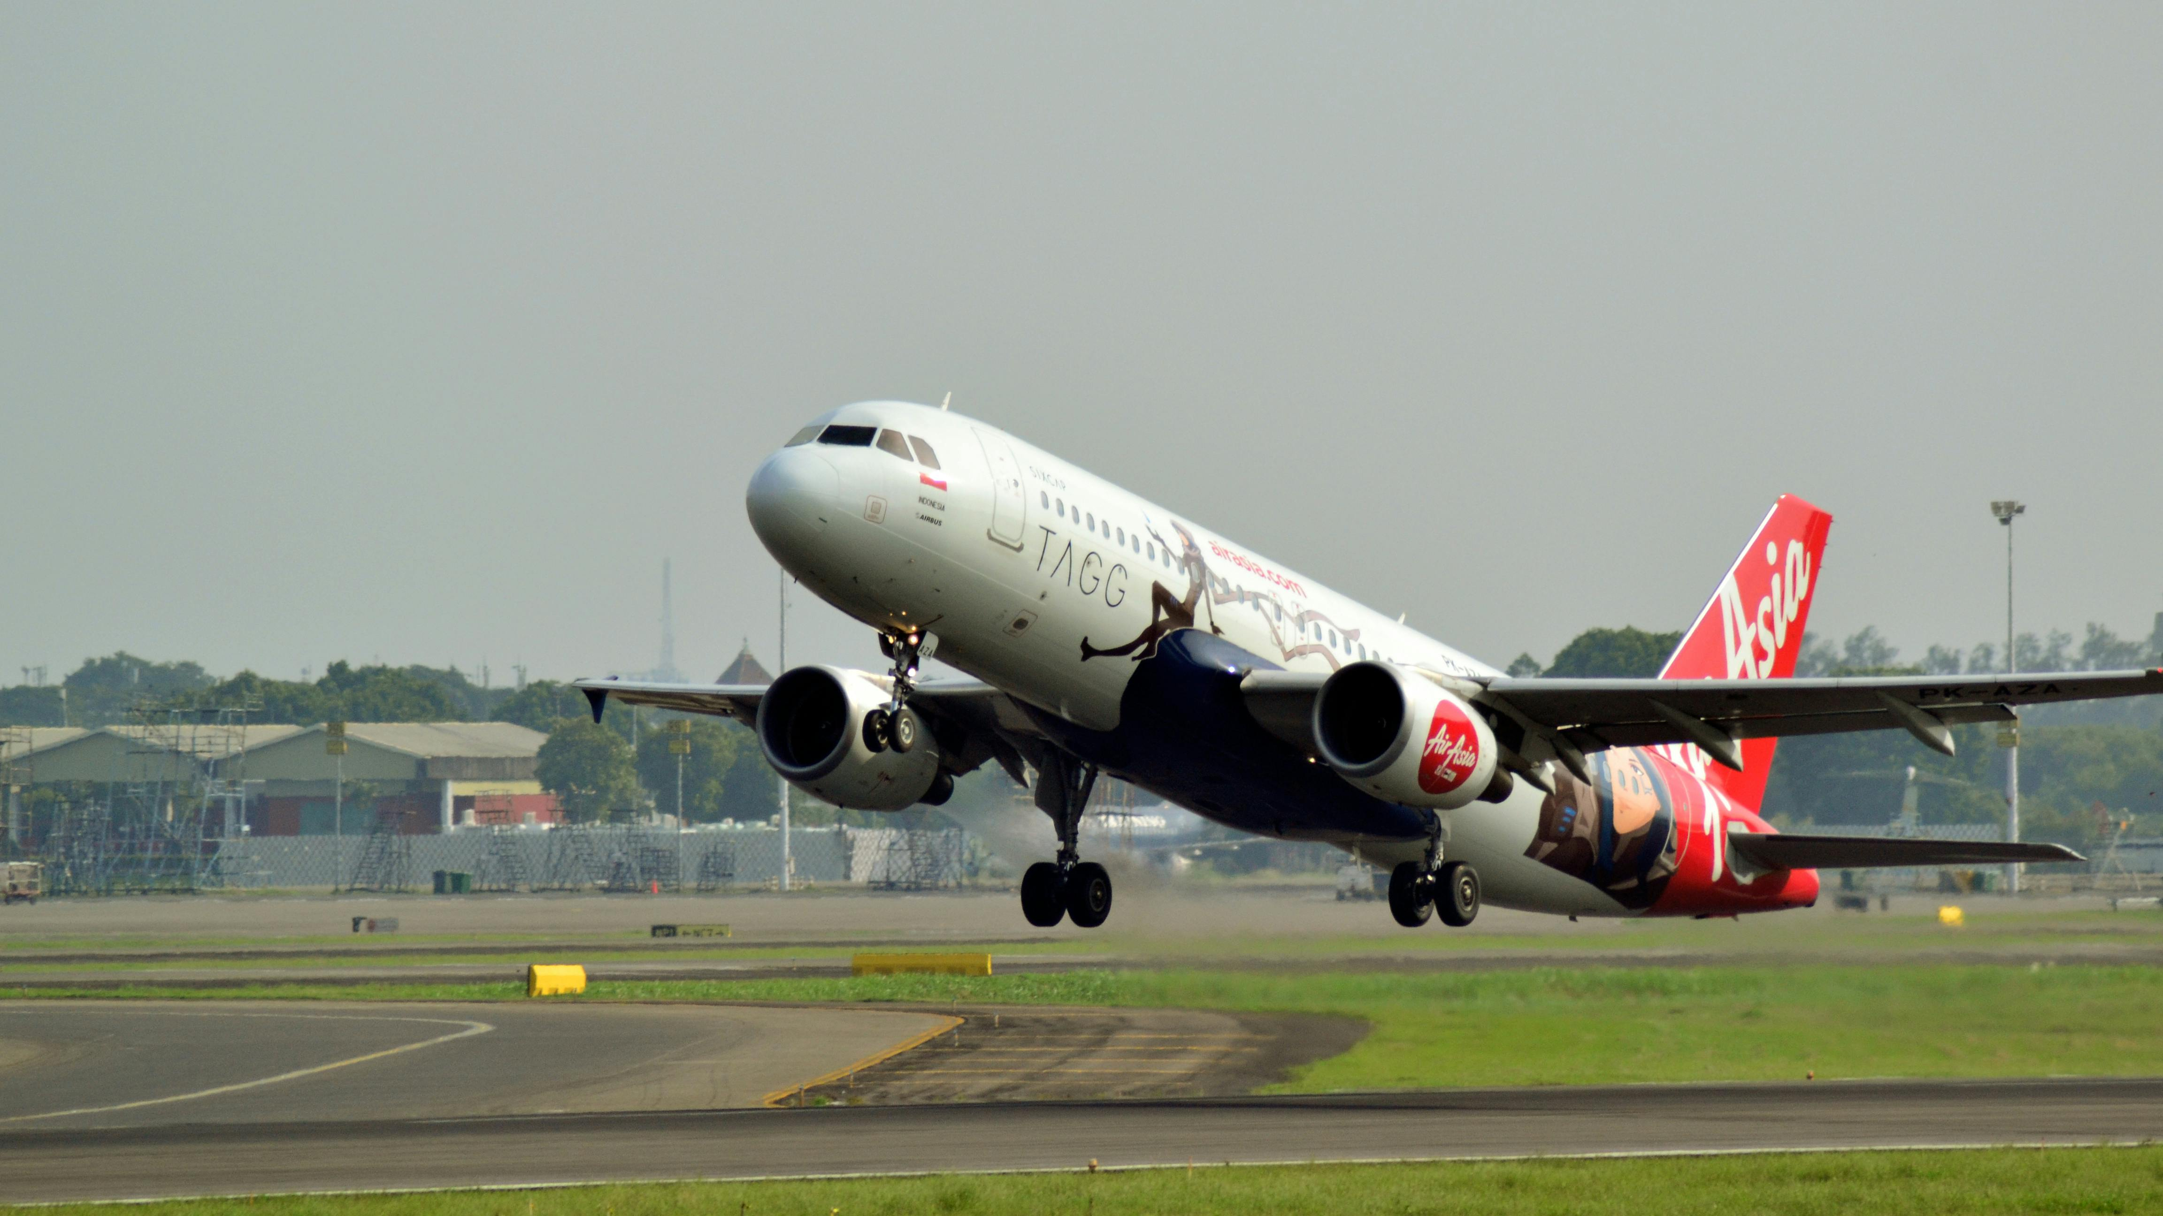
INTRODUCTION
Airline which is an aviation company must play a great role in improving their customer satisfaction and overall performance retention. Due to high rate in competition in the airline industry, an airline company must effectively assess and improve their services to meet traveler’s expectations. The rapid growth in data analytics has enabled us to analyze large response of ratings from customer's feedback and has made known the key drivers of satisfactions and highest of all to navigate how to put in place strategies to retain customer and improve service quality.

Slide 3
METHODOLOGY
DATE SOURCE: Kaggle
DATA CLEANING: Power query
DATA VISUALIZATION: PowerBI
DOCUMENTATION: Ms Word
PROJECT PRESENTATION: Ms Powerpoint

Slide 4
PROBLEM STATEMENT/OBJECTIVE
PROBLEM STATEMENT: Our airline has some ratio of disloyal customer that remains a challenge due to different expectations of travelers which the company intends to drive to the positive side . The company brought into account rating based on key satisfaction preferences.
Key challenges include:
Analyzing the ratio of satisfied customers to unsatisfied/neutral customers
Identifying demographic factors such as gender and age
Assessing the count of customers across each class
Understanding a few reasons behind customer disloyalty
OBJECTIVE :After conducting an analysis through reviews to identify and address the reasons behind customer dissatisfaction, the objective is to identify how to improve operational efficiency such as delays in arrival and departure where the airline is failing to satisfy the passenger’s expectations.

